Slide 1
Full Stack Development
Palanisamy Thangamuthu

Slide 2
What is Full Stack?
Full stack development is the process of designing, creating, testing, and deploying a complete web application from start to finish.
Involves working with various technologies and tools, including front-end web development, back-end web development, and database development.
Responsible for the entire web application development process.
High demand because they can build a website or application from start to finish and quickly

Slide 3
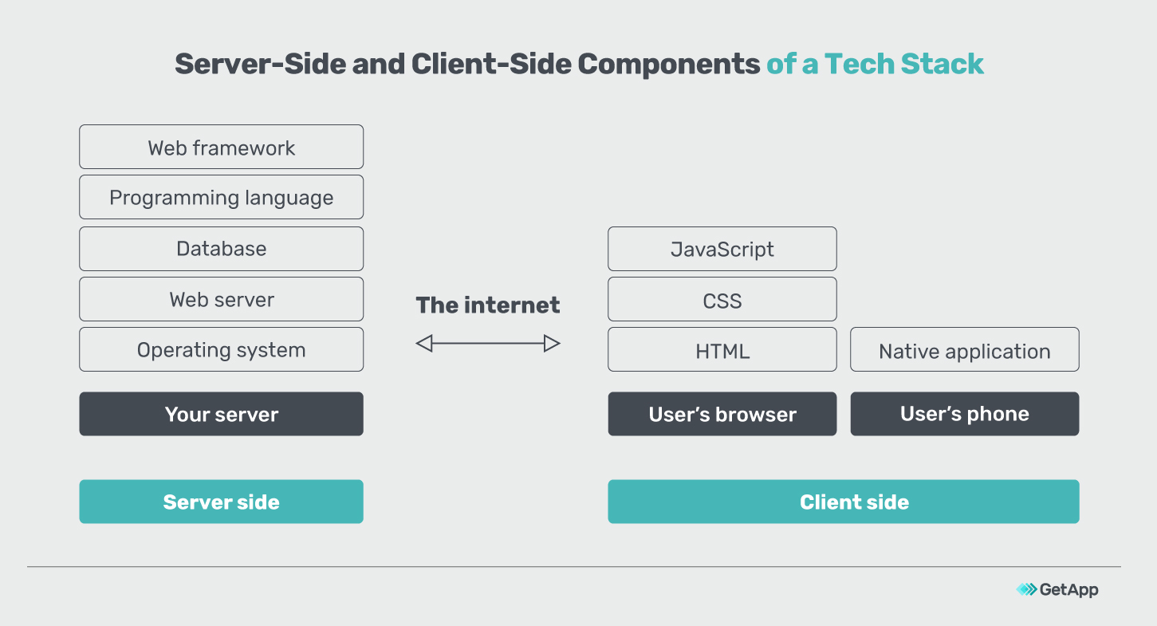
How Web Application Works?

Slide 4
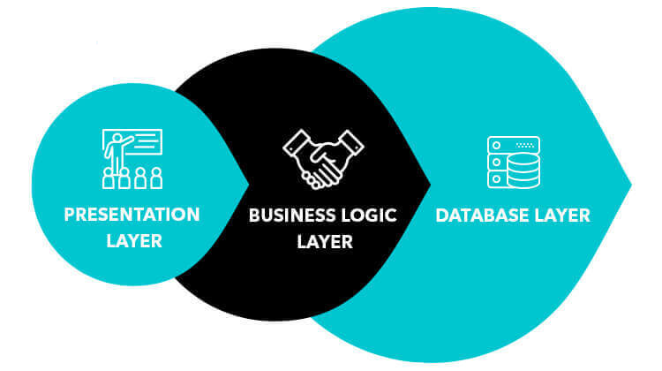
Traditional Web Development

Slide 5
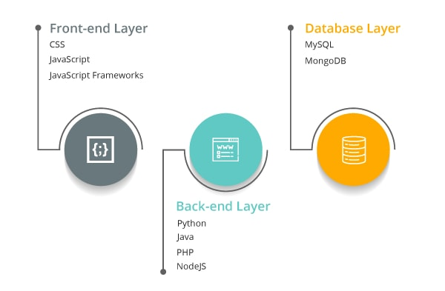
Full Stack Development

Slide 6
Frontend Technologies
HTML
CSS
Javascript Libraries such as jQuery, React, ZeptoJS
Frameworks like Angular, Vue, Backbone, Ember
Bootstrap

Slide 7
Backend Technologies
Java(Spring)
PHP(Laravel)
NodeJs(Express)
Python(Django, Flask, Pylons)
Ruby(Ruby on Rails)

Slide 8
Databases
Mysql
PostgreSQL
MongoDB
CouchDB
Oracle

Slide 9
Servers
Apache
Nginx

Slide 10
Popular Stacks
MEAN Stack: MongoDB, Express, AngularJS and Node.js.
MERN Stack: MongoDB, Express, ReactJS and Node.js
Django Stack: Django, python and MySQL as Database.
Rails or Ruby on Rails: Uses Ruby, PHP and MySQL.
LAMP Stack: Linux, Apache, MySQL and PHP.

Slide 11
Frontend Technologies
HTML, CSS, Bootstrap & React

Slide 12
What is React.js?
React is a javascript library for building user interfaces
It is a Library not a framework like Angular, Backbone, etc..
Developed by Facebook
Opensource.

Slide 13
Why was React developed?
Complexity of two-way data binding
Bad UX from using “cascading updates” of DOM tree
A lot of data on a page changing over time
Complexity of Facebook’s UI architecture
Shift from MVC mentality

Slide 14

Who uses React?

Slide 15
React.JS History
Facebook Software Engineer, Jordan Walke, created it.
React.JS was first used in 2011 for Facebook's Newsfeed feature.
Initial Release to the Public (V0.3.0) was in July 2013.
Current version of React.JS is V18.0.0 (April 2022).

Slide 16
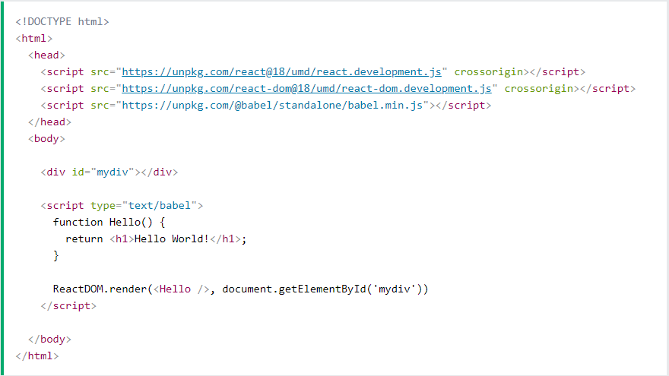
React Getting Started

Slide 17
React Getting Started…
3 Libraries included react, react-dom, babel.
First two let us write React code in our JavaScripts.
Babel, allows us to write JSX syntax and ES6 in older browsers.
To use React in production, you need npm which is included with Node.js.

Slide 18
Setting up a React Environment
Creating a React application requires you to set up build tools such as Babel and Webpack.
These build tools are required because React's JSX syntax is a language that the browser doesn't understand.
Create React App (CRA) is a tool to create single-page React applications that is officially supported by the React team.

Slide 19
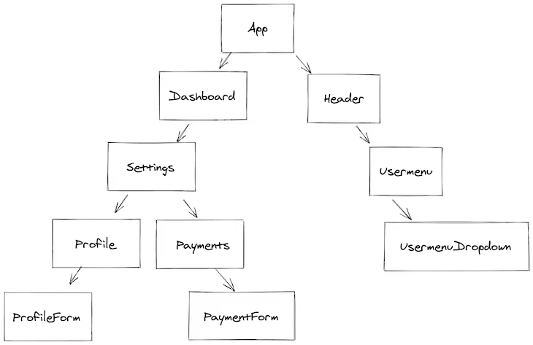
React Fundamentals - Application Structure

Slide 20
React Fundamentals - Component
Components are self-contained reusable building blocks of web application.
React components are basically just idempotent functions (same input produces same output).
They describe your UI at any point in time, just like a server-rendered app.

Slide 21
React Fundamentals - Props
props stands for properties.
Props are arguments passed into React components.
Props are passed to components via HTML attributes.
accessed via this.props or props (in functional component).

Slide 22
React Fundamentals - State
Represents internal state of the component
Accessed via this.state
When a component's state data changes, the rendered markup will be updated by re-invoking render() method
The state can be updated by the props cannot.

Slide 23
React Events
Just like HTML DOM events, React can perform actions based on user events.
React has the same events as HTML: click, change, mouseover etc.
React events are written in camelCase syntax.
React event handlers are written inside curly braces.

Slide 24
React Router
Create React App doesn't include page routing.
React Router is the most popular solution.
To add it, run:
npm install --save react-router-dom

Slide 25
CRUD Operations
Create
Read
Update
Delete

Slide 26
Database
MongoDB

Slide 27
What is a database
A database is a structured, organized set of data.
Common examples of databases:
Telephone book
Student records
Database management systems are computer software applications that interact with user, other apps, and the db itself to capture and analyze data.
Well-known DBMSs include MYSQL, PostgreSQL, Oracle and IBM DB2

Slide 28
MongoDB - What is MongoDB
Scalable High-Performance Open-Source, Document-oriented database.
Built for Speed.
Rich document based queries for Easy readability.
Full index support for High Performance.
Replication and Failover for High Availability.
Map/Reduce for Aggregation.

Slide 29
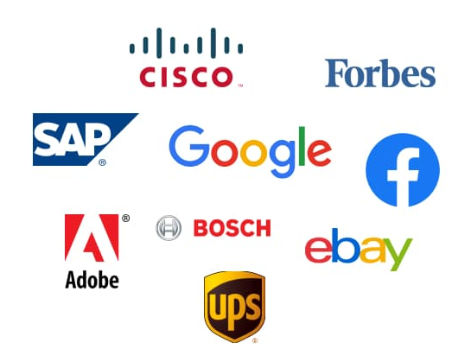
Who is using MongoDB?

Slide 30
Database = Database
Made up of multiple collections.
Created on-the-fly when referenced for the first time.

Slide 31
Collection = Table
Schema-less, and contains documents.
Indexable by one or more keys.
Created on-the-fly when referenced for the first time.
Capped Collections: Fixed size, older records get dropped after reaching the limit.

Slide 32
Document = Record
Stored in a collection.
Can have _id key - works like primary keys in mySQL
Supported relationships.
Document storage in BSON(Binary form of JSON) format.

Slide 33
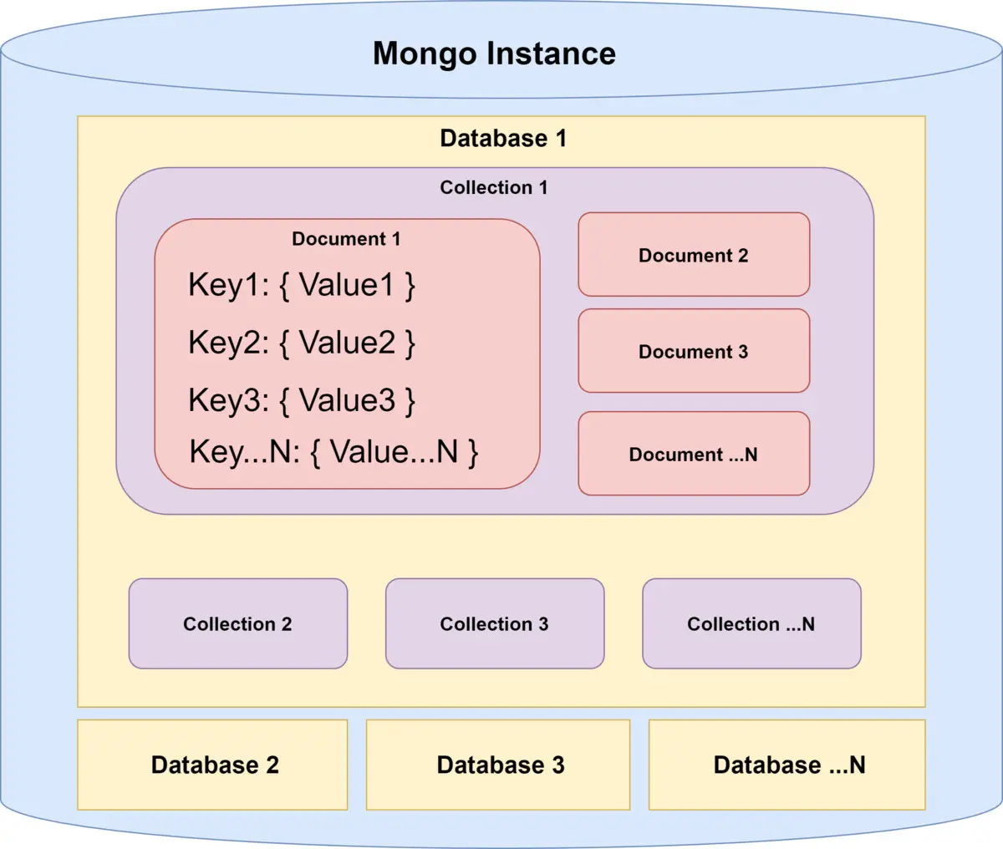
Database - How it look likes?

Slide 34
Backend
NodeJs & Express

Slide 35
What is NodeJS?
In simple words it is “Server side Javascript”.
V8 is open-source Javascript engine developed by Google. Its written using C++ and used in chrome browser.
Node.js runs on V8.
Its open-source runs on Linux, Windows and other OS as well.
High performance network applications framework, well optimized for concurrent environments.

Slide 36
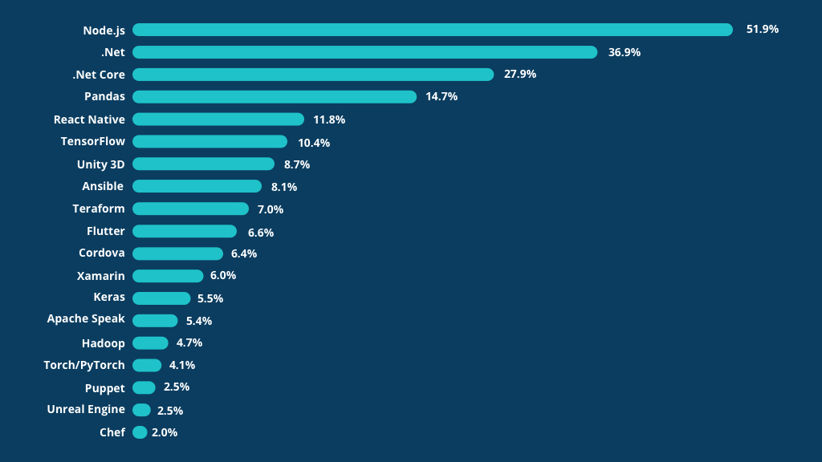
NodeJS Benchmarks

Slide 37
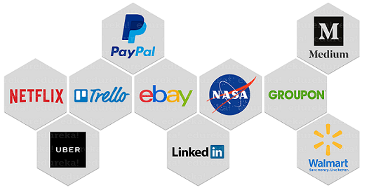
Who is using NodeJS

Slide 38
What is Express Js?
Minimalist web application framework
Runs on NodeJS.
It is used to build a single page, multipage, and hybrid web application.
It's a layer built on the top of the Node js that helps manage servers and routes.

Slide 39
Express - REST API Overview
Method | URLs | Action
GET | /users | Get all users
GET | /users/:id | Get the user by id
POST | /users | Add a new user
PUT | /users/:id | Update the user by id
PATCH | /users/:id | Update the user properties by id
DELETE | /users/:id | Remove the user by id

Slide 40
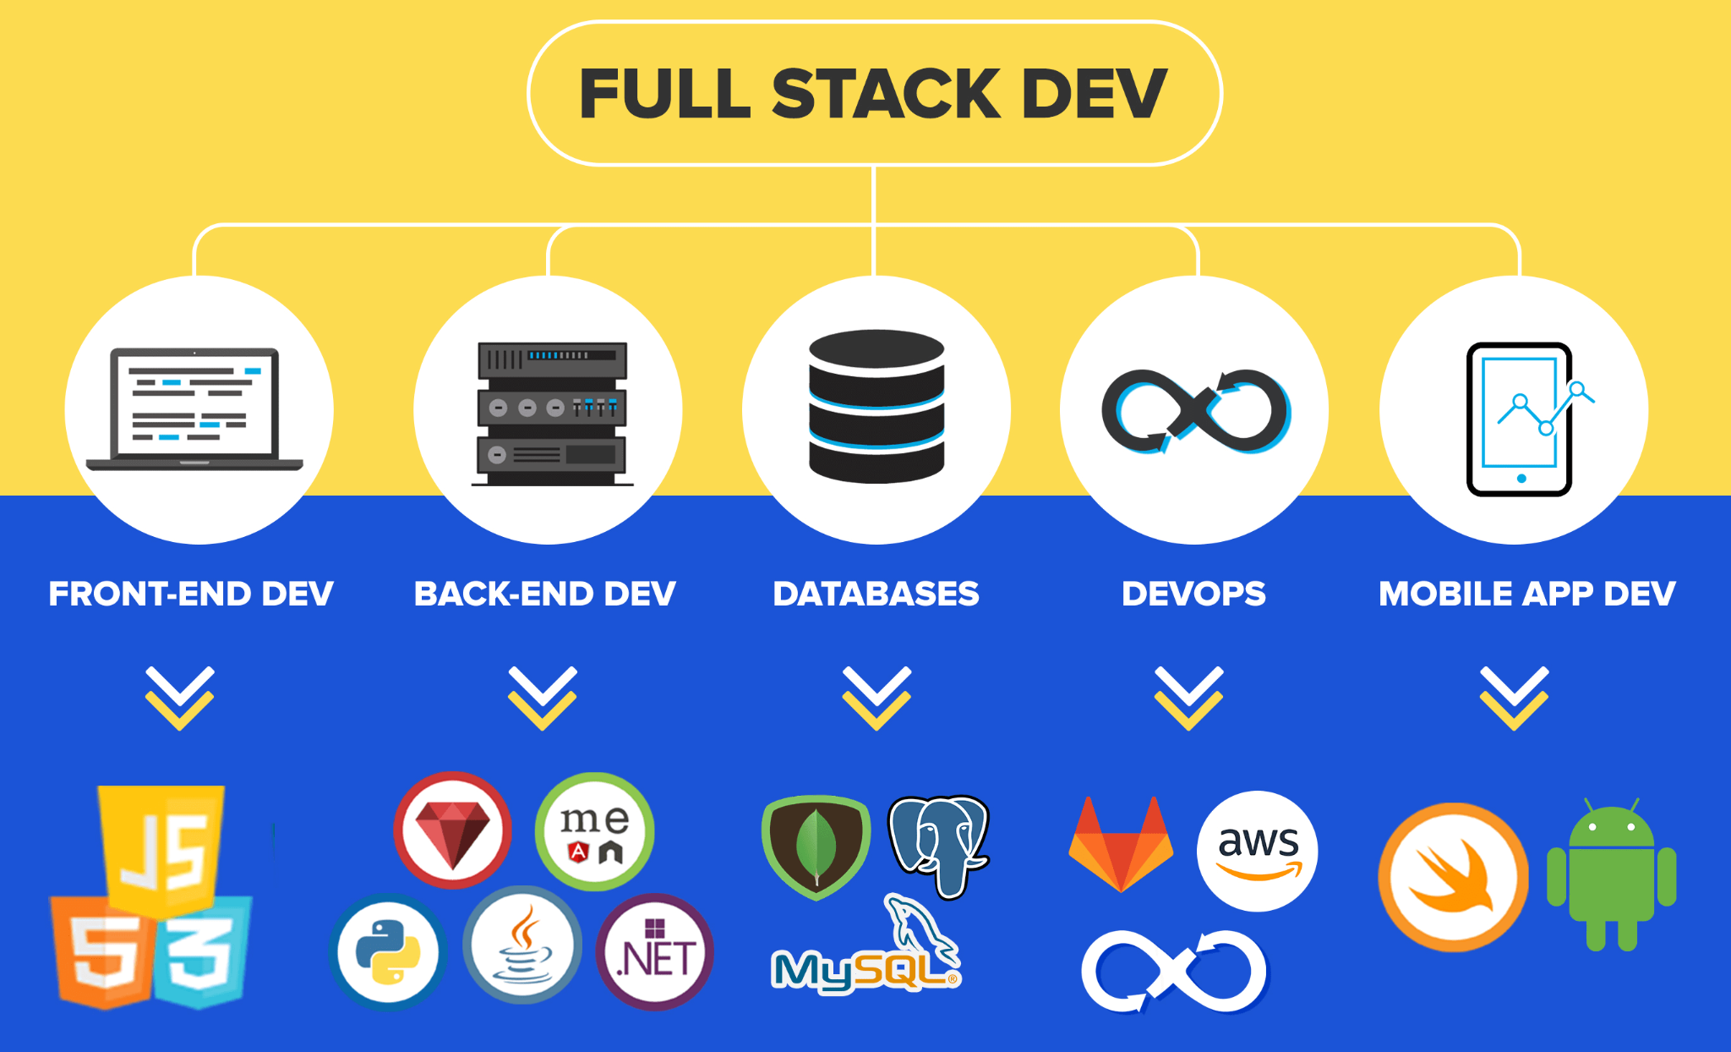
FSE - Roadmap

Slide 41
Thank You!!
9952175204
mailtopalanii@gmail.com
https://www.linkedin.com/in/tpalanii/

